Slide 1
Risk Game
SOEN 6441 – Build 1
Team 8 Members: Meng Yao, Jaspreet, Somayeh Abedi, Urbashi Bhattacharjee, Ramit Basra

Slide 2
Agenda
Architecture
Demonstration
Members’ division of labor

Slide 3
Architecture Design
This Game implements Model-View-Controller for Map Editor & Entire Game Play
We have used observer pattern for deploying MVC design.

Slide 4
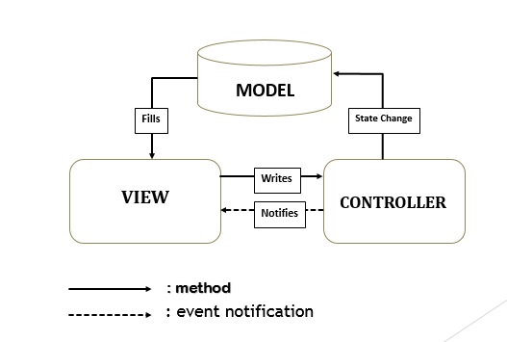
Architecture
Figure: Architecture Design for Risk Game

Slide 5
Model Layer
Entire classes & objects
CountryMap ():
i) saves map ii) add or remove country iii) add or remove continent
graph.getModel().beginUpdate(): it updates the country class

Slide 6
Model Layer
loadBoard (): loads board if countries, adjacency of countries & continent is true,
Risk_Model (): i) loads board ii) initialize game iii) make turns of player iv) reinforce v) fortify
CountryLabel(), RiskListModel() : i) updates countries, adjacency and occupied countries per player turn
RiskListModel() and CountryLabel() extends Observer
Risk_Model () extends Observable

Slide 7
View Layer
Customer View: BoardView, PlayerCount_View, PlayerSetting_View, MenuView, Risk_Start_View,
Awt: Dimension, GridLayout, BufferedImage, BorderLayout, FlowLayout
Swing: JComponent, JButton, JDialog, JFrame, Jpanel, JComboBox, JTextField, Box

Slide 8
View Layer
Core Classes for Displaying
BoardView(): i) add frame properties ii) connect with map image
iii) listen to user action
MenuView(): i) save ii) pause iii) quit game
PlayerCount_View(): Player number selection
PlayerSetting_View(): takes player name

Slide 9
Controller Layer
User Input and manipulation
ActionListener interface: menubutton.addActionListener(), reinforcebutton.addActionListener(), endturn.addActionListener().
ListSelectionModel interface: addListSelectionListener().
ActionEvent:
getActionCommand() : a semantic event which indicates that a component-defined action has occurred.
ActionEvent: evt.getActionCommand(), actionEvent.equals().

Slide 10
Controller Layer
ListSelectionEvent : evt.getValueIsAdjusting().
Java.util.Scanner: take user inputs from System.in.

Slide 11
Members Division of Work
Map Editor: Jaspreet ,Somayeh Abedi, Meng Yao
Game Play: Meng Yao
Startup Phase: Urbashi Bhattacharjee, Ramit Basra
Reinforcement & Fortification Phase: Yao Meng
Architectural Design & API Documentation: Urbashi Bhattacharjee & Ramit Basra
Unit Testing: Yao Meng

